Slide 1

Data Structures and Abstractions with Java™
5th Edition
Chapter 24
Trees

Slide 2
Agenda:
Homework: questions?
Don't forget: "Best move" is much less important than "some move"

Slide 3
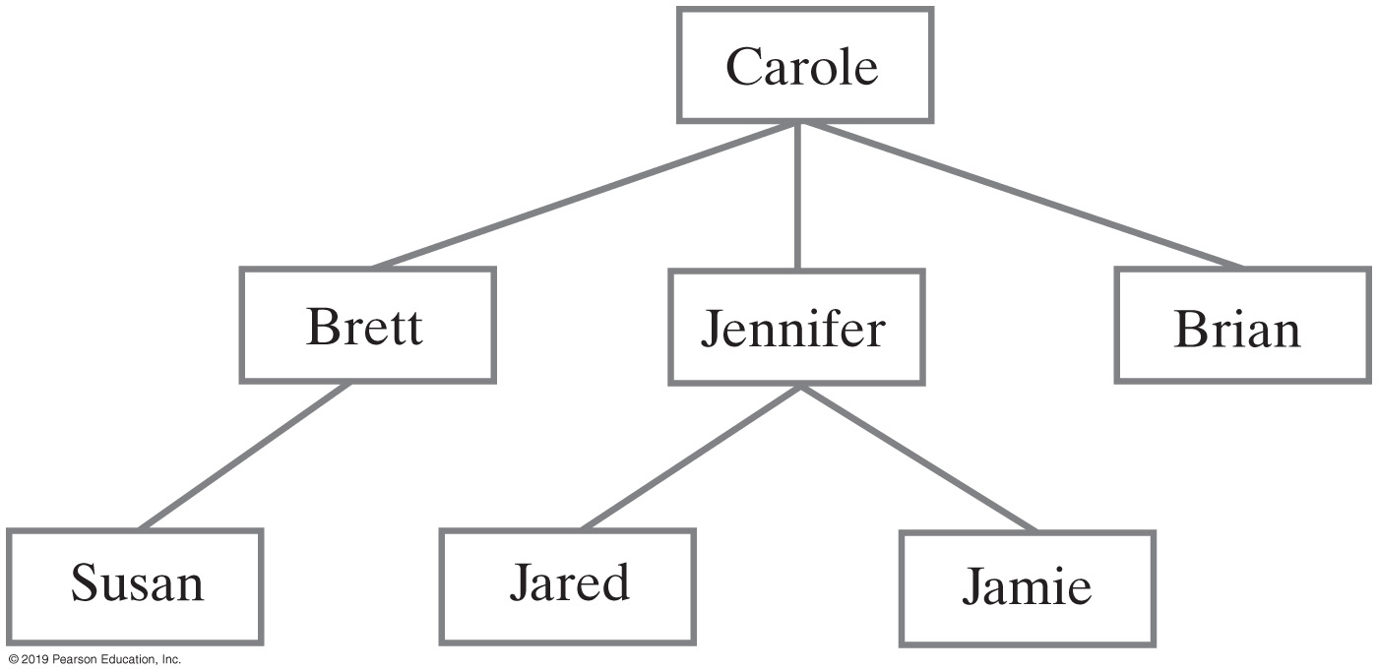
Hierarchical Organizations
FIGURE 24-1 Carole’s children and grandchildren

Slide 4
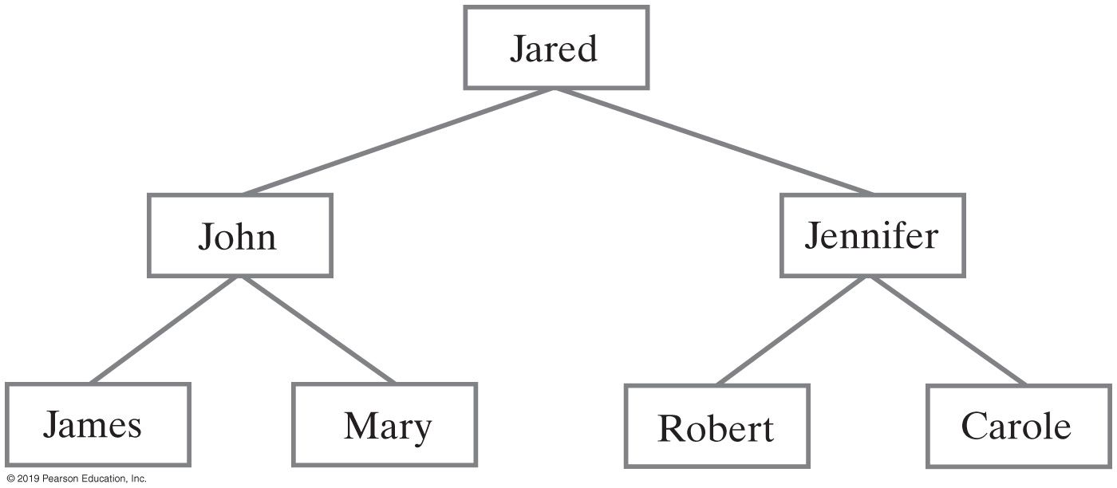
Hierarchical Organizations
FIGURE 24-2 Jared’s parents and grandparents

Slide 5
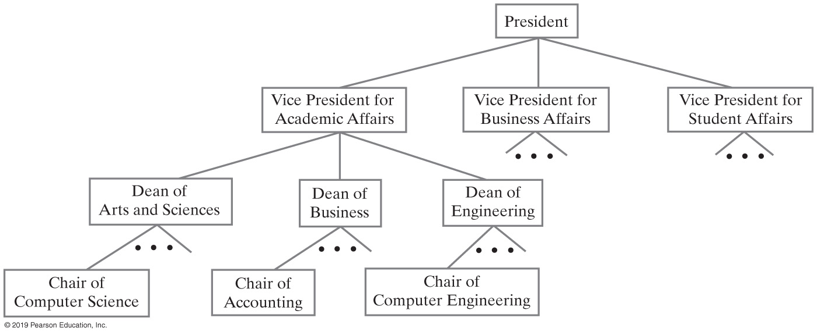
Hierarchical Organizations
FIGURE 24-3 A portion of a university’s administrative structure

Slide 6
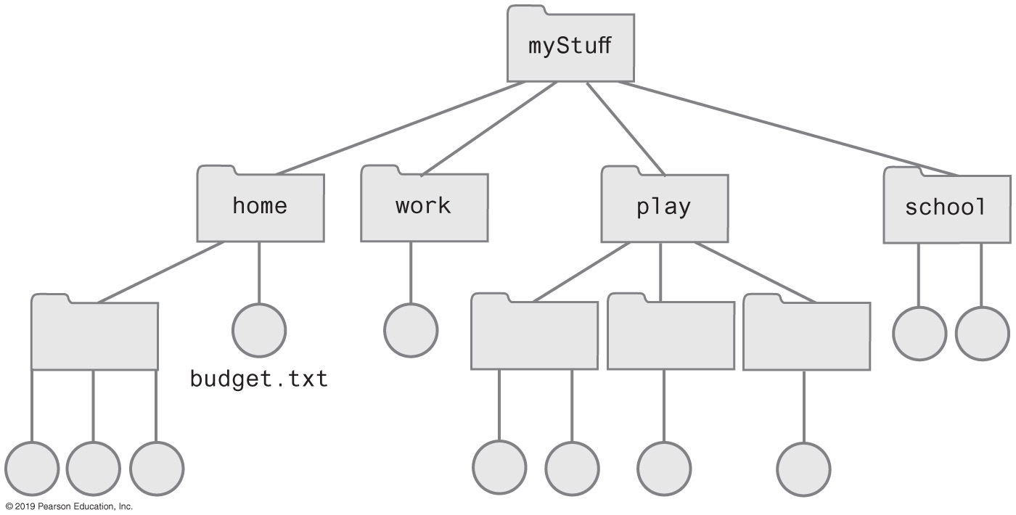
Hierarchical Organizations
FIGURE 24-4 Computer files organized into folders

Slide 7
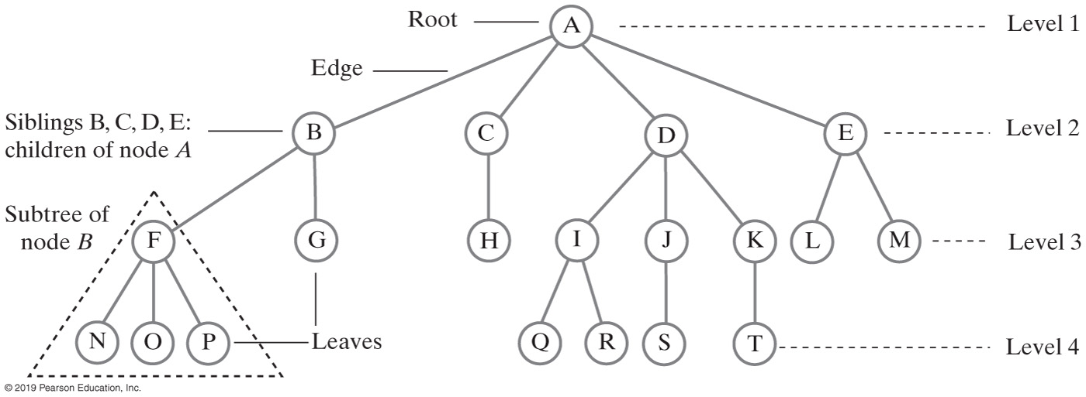
Tree Terminology
FIGURE 24-5 A tree equivalent to the tree in Figure 24-4

Slide 8
Tree Terminology
Contrast plants with root at bottom
ADT tree with root at top
Root is only node with no parent
A tree can be empty
Any node and its descendants form a subtree of the original tree
The height of a tree is the number of levels in the tree
Height of tree T = 1 + the height of the tallest subtree of T

Slide 9
Tree Terminology
Which nodes are the leaves?
Which nodes are the sibling of node K?
Which nodes are the children of node B?
Which nodes are the descendant of node B?
Which nodes are the ancestor of node B?
Which nodes are parents?

Slide 10
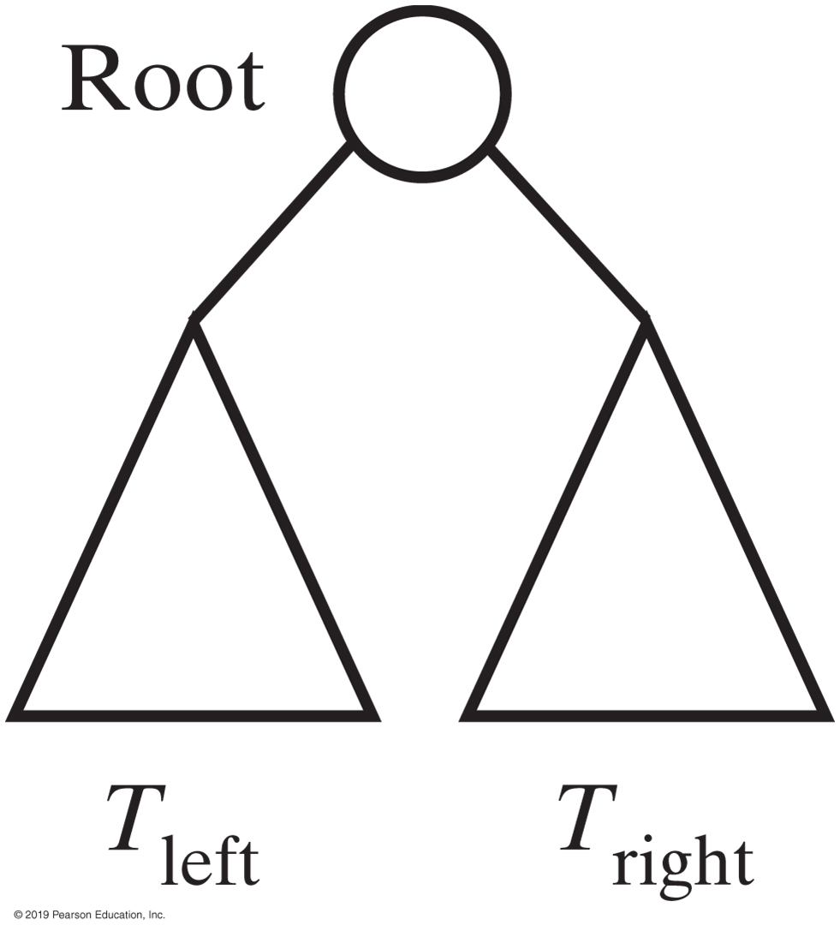
Binary trees

Slide 11
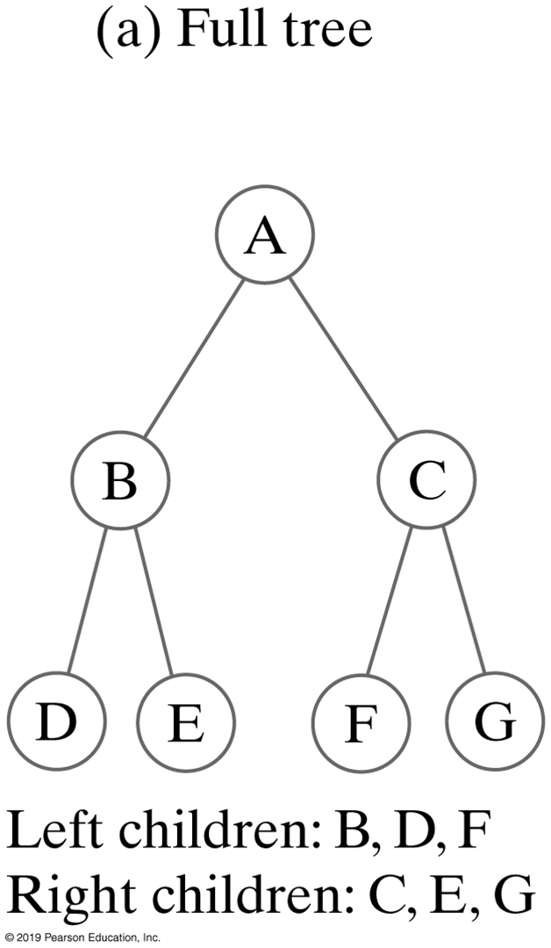
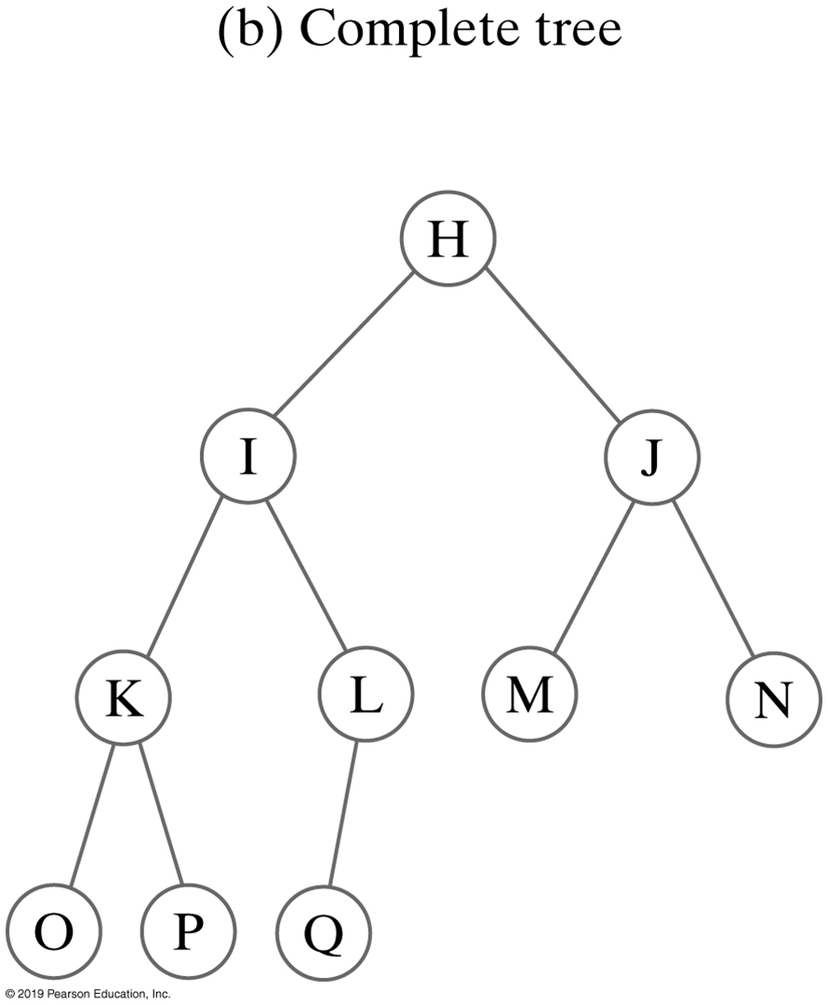
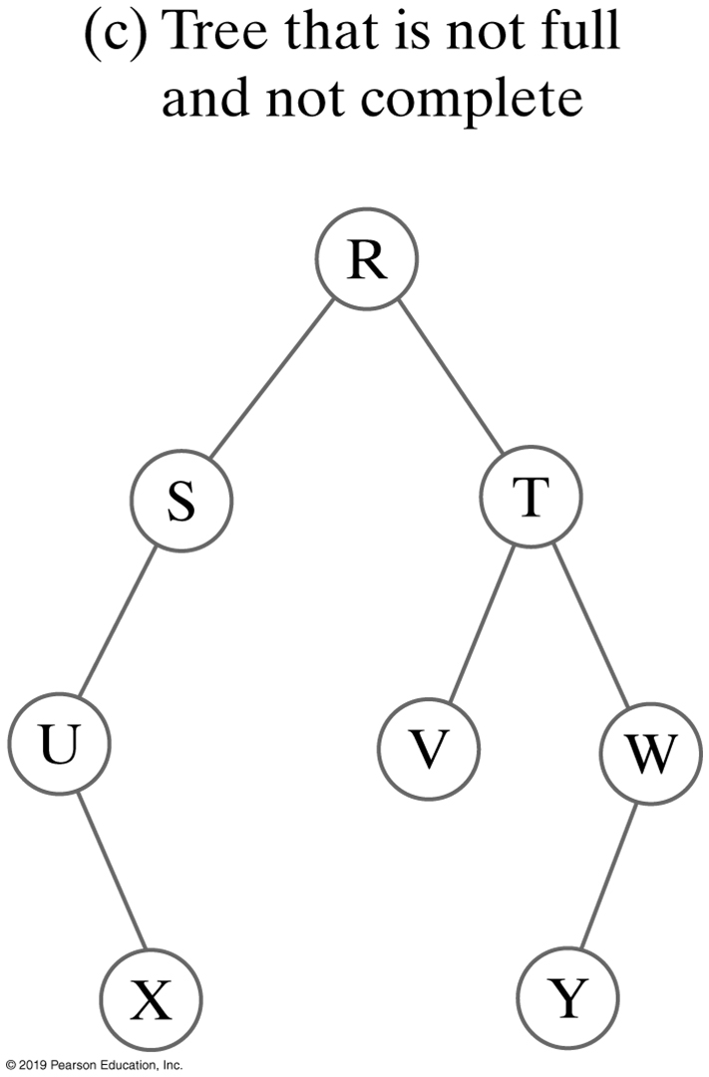
Binary Trees
FIGURE 24-6 Three binary trees

Slide 12
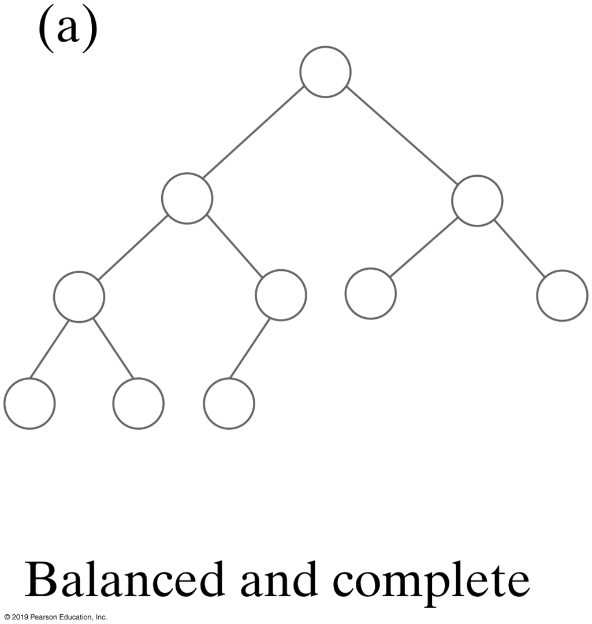
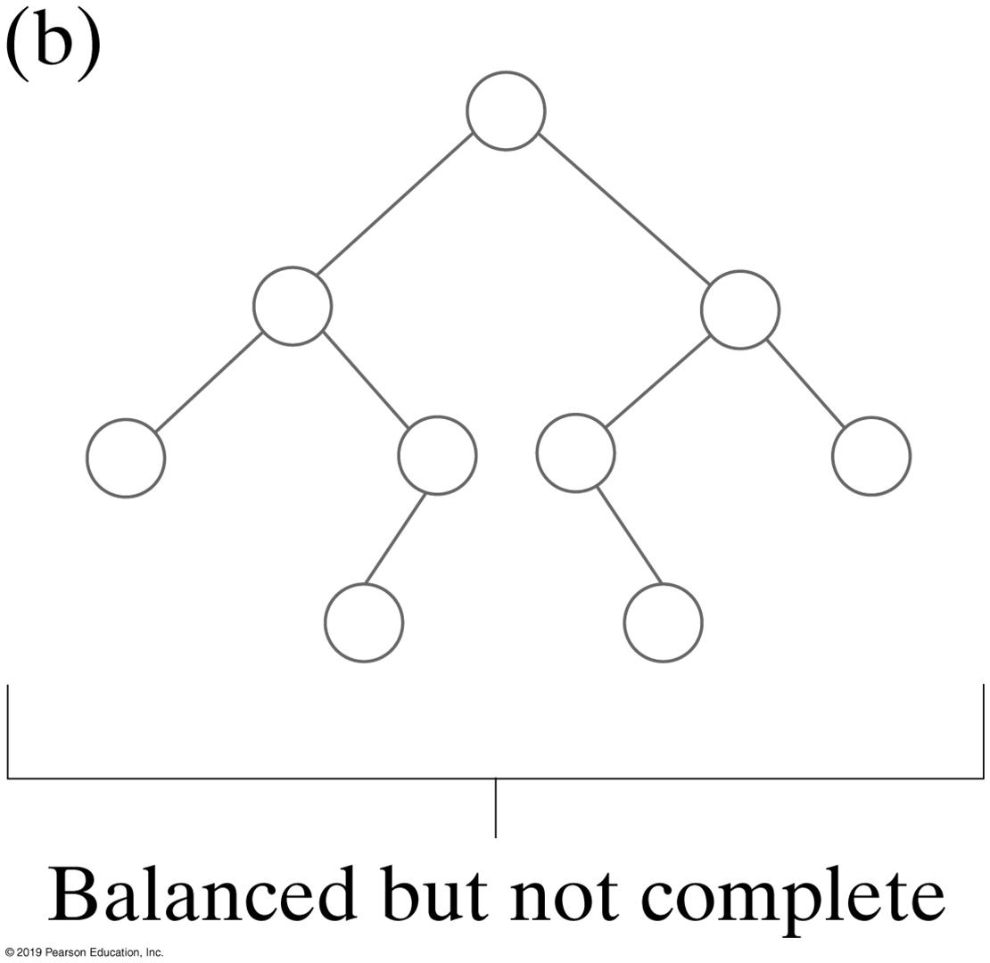
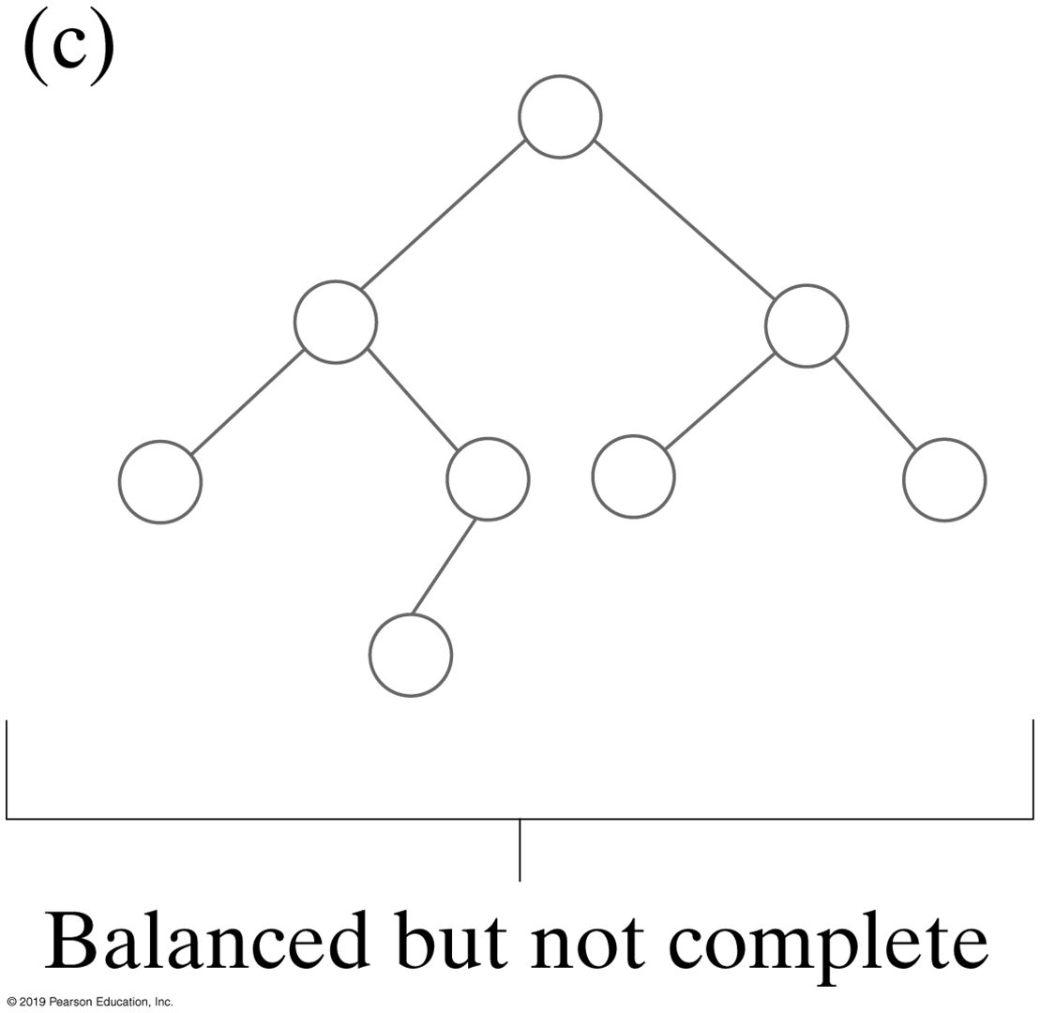
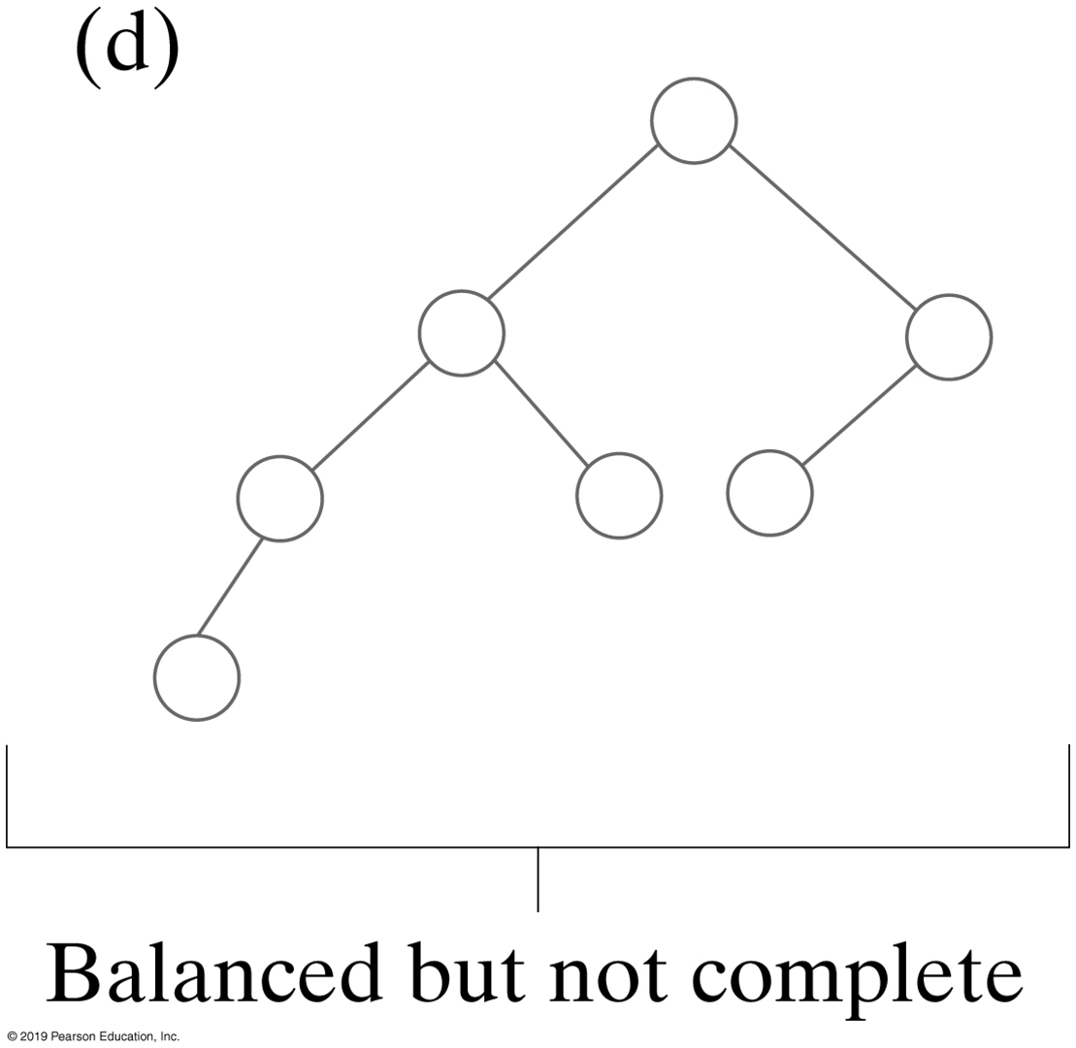
Binary Trees
Balanced, but not complete
height(leftSubTree)−height(rightSubTree) <= 1
FIGURE 24-7 Some binary trees that are height balanced

Slide 13
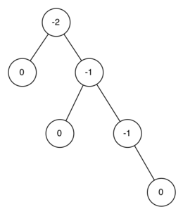
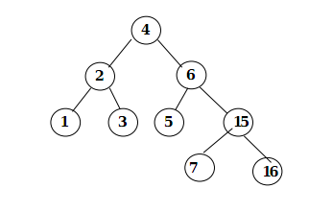
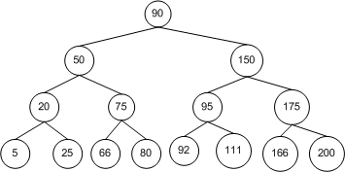
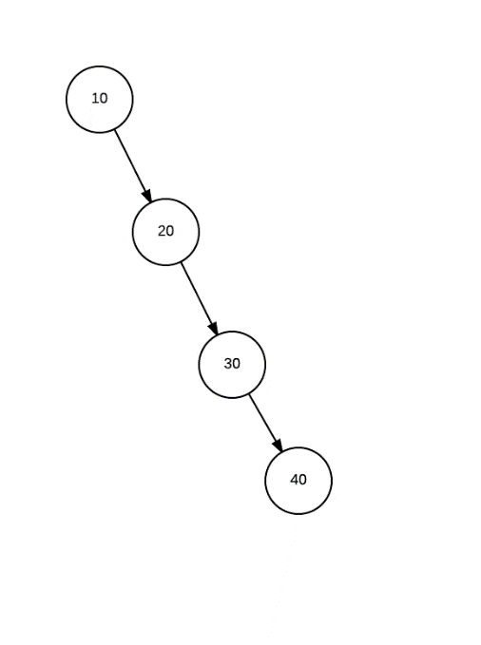
Binary Trees

Slide 14
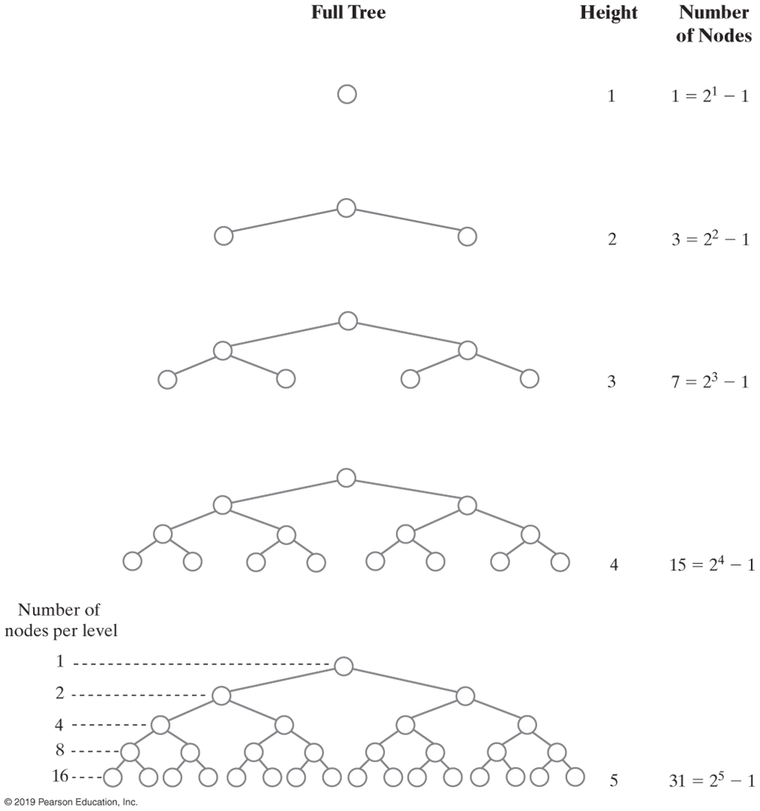
Binary Tree Height (Part 1)
FIGURE 24-8 The number of nodes in a full binary tree as a function of the tree’s height

Slide 15
Binary Tree Height (Part 2)
FIGURE 24-8 The number of nodes in a full binary tree as a function of the tree’s height

Slide 16
Traversals of A Tree
Traversal:
Visit, or process, each data item exactly once
Order in which we visit items is not unique

Slide 17
Traversals of a Binary Tree
We use recursion
To visit all the nodes in a binary tree, we must
Visit the root
Visit all the nodes in the root’s left subtree
Visit all the nodes in the root’s right subtree

Slide 18
Traversals of a Binary Tree
Preorder traversal
Visit root before we visit root’s subtrees
Inorder traversal
Visit root of a binary tree between visiting nodes in root’s subtrees.
Postorder traversal
Visit root of a binary tree after visiting nodes in root’s subtrees
Level-order traversal
Begin at root and visit nodes one level at a time

Slide 19
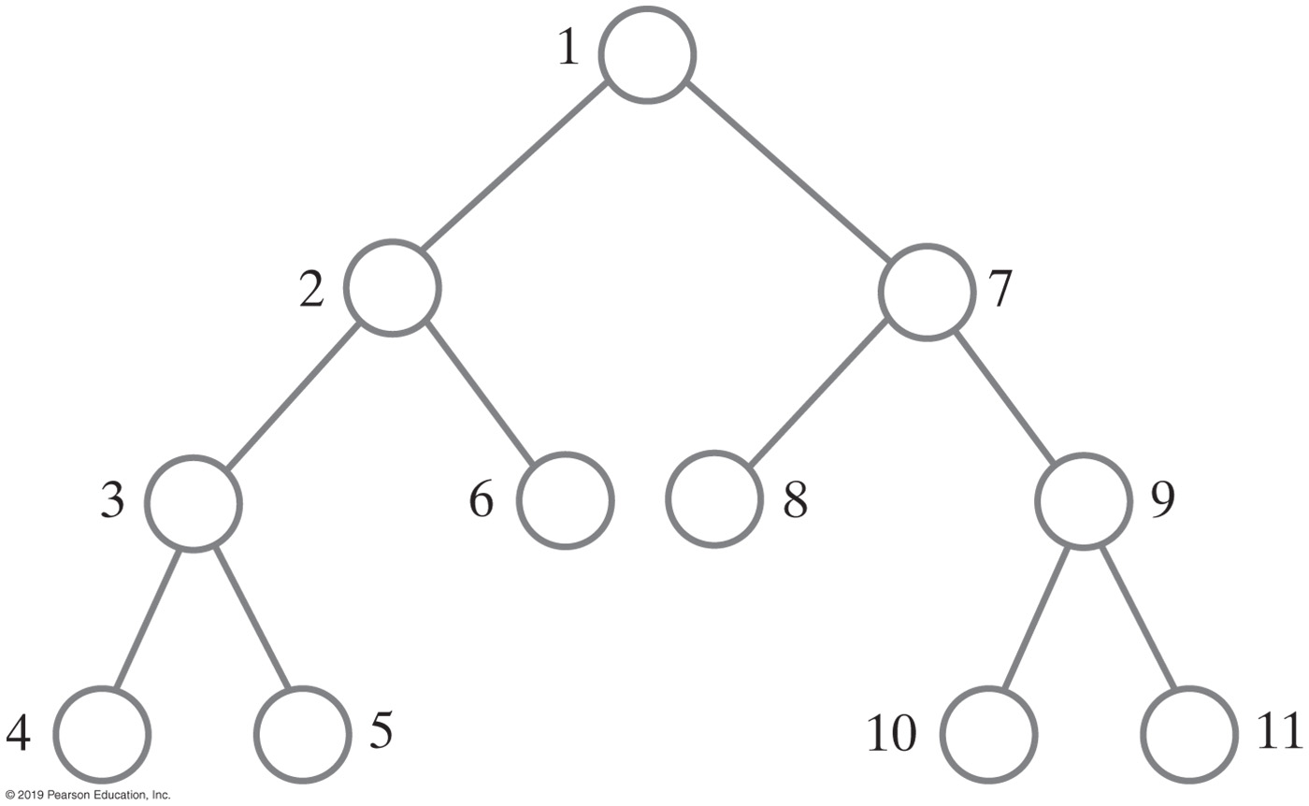
Traversals of a Binary Tree
Preorder traversal
Visit root before we visit root’s subtrees

Slide 20
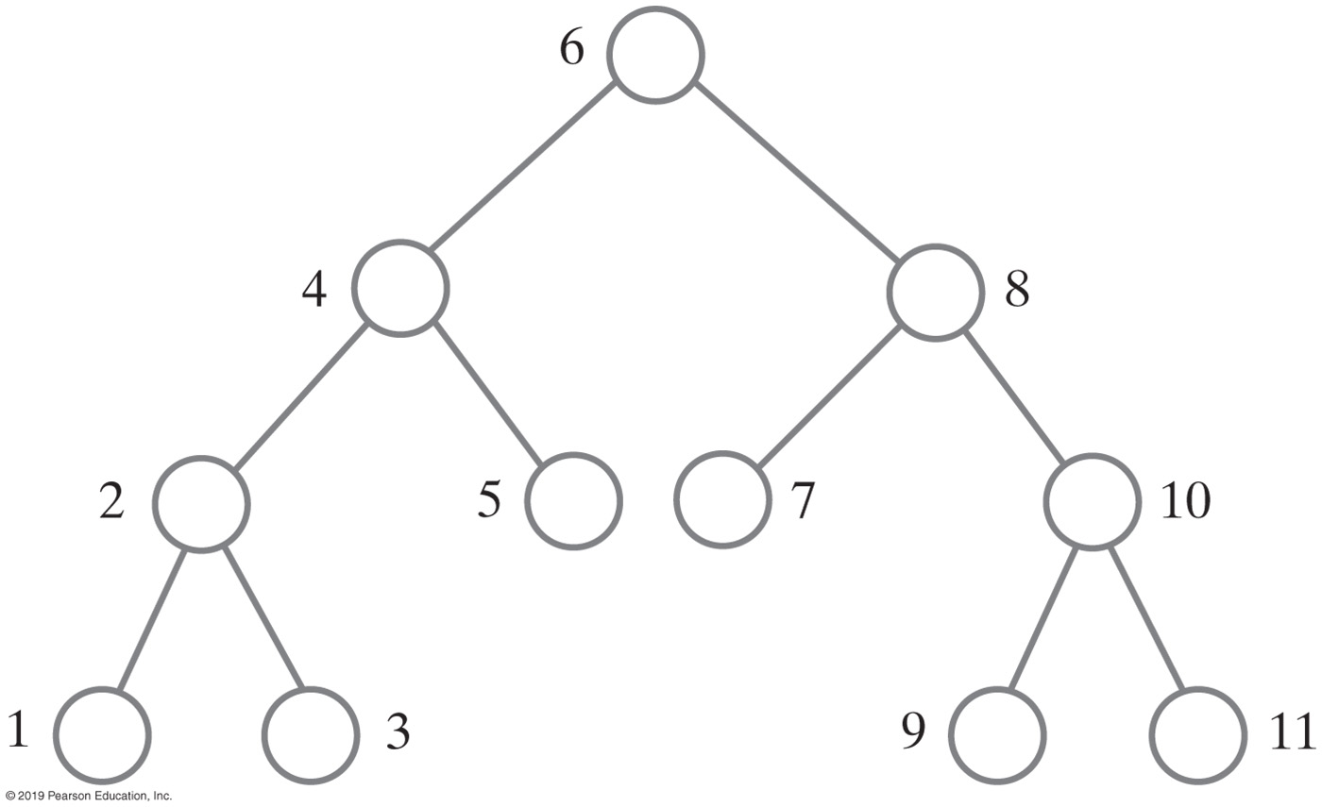
Traversals of a Binary Tree
Inorder traversal
Visit root of a binary tree between visiting nodes in root’s subtrees

Slide 21
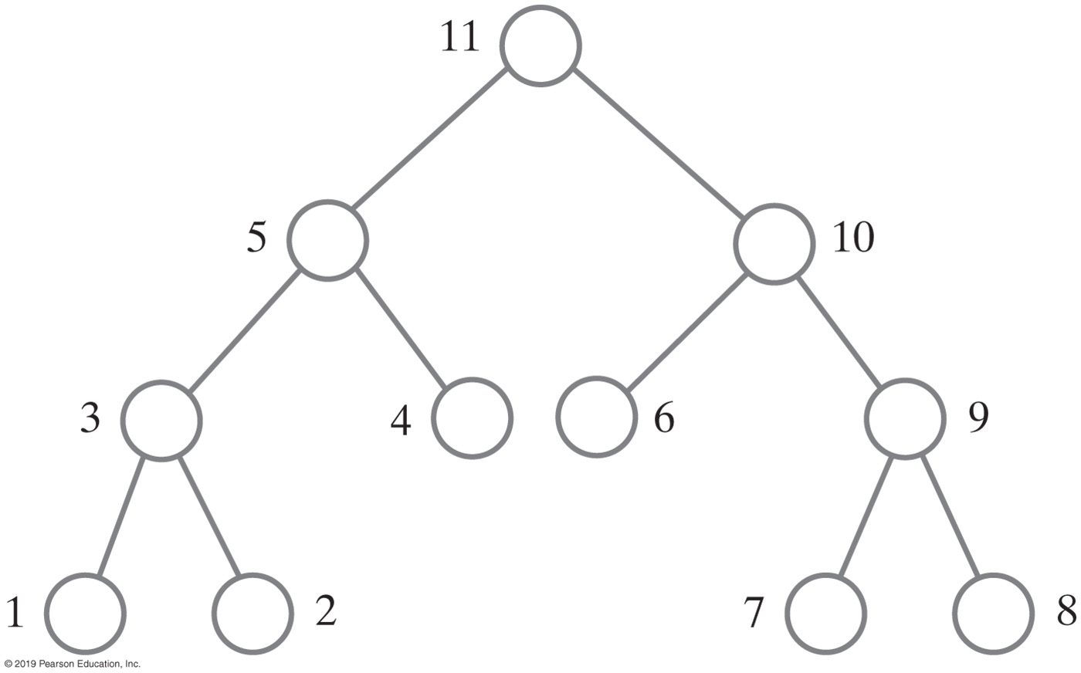
Traversals of a Binary Tree
Postorder traversal
Visit root of a binary tree after visiting nodes in root’s subtrees

Slide 22
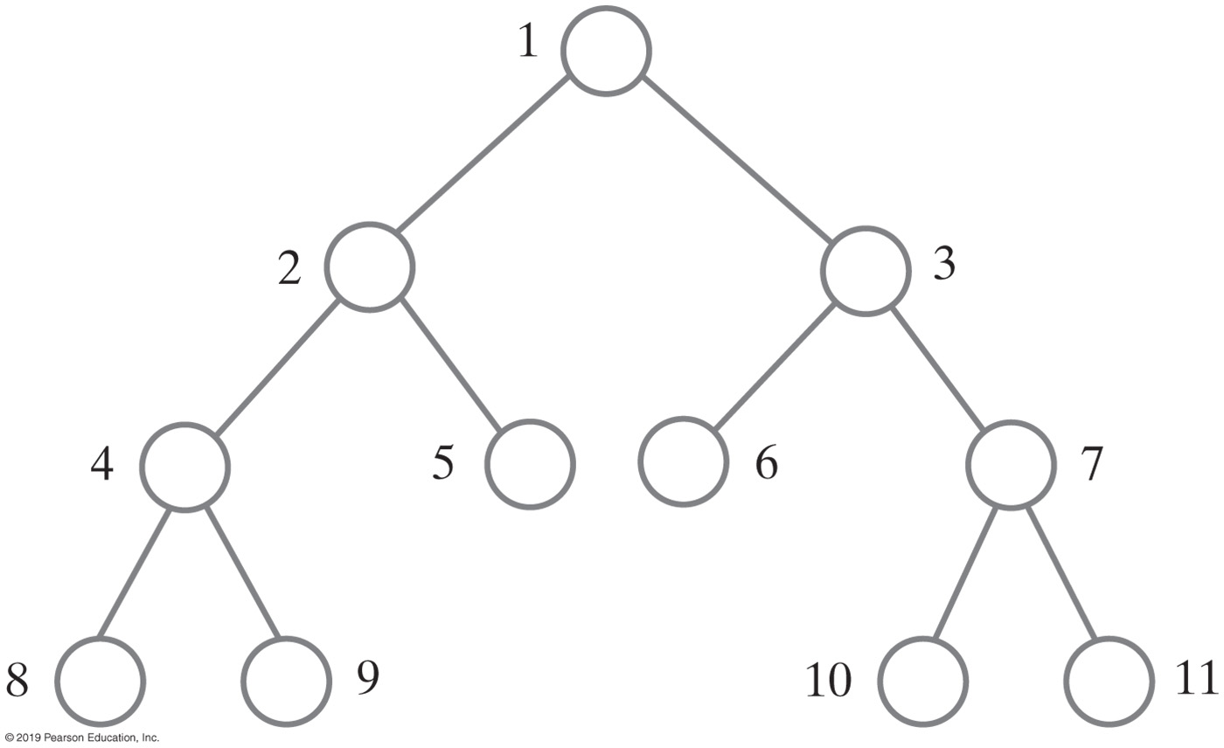
Traversals of a Binary Tree
Level-order traversal
Begin at root and visit nodes one level at a time

Slide 23
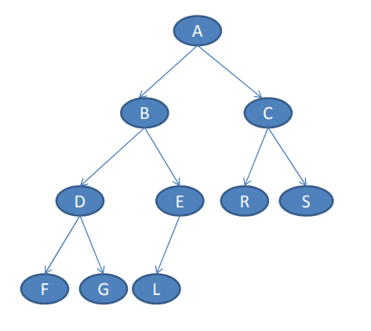
Traversals of a Binary Tree

Slide 24
Traversals of a Binary Tree
In: F, D, G, B, L, E, A, R, C, S
Post: F, G, D, L, E, B, R, S, C, A
Pre: A, B, D, F, G, E, L, C, R, S

Slide 25
Interfaces for All Trees
package TreePackage;
/** An interface of basic methods for the ADT tree. */
public interface TreeInterface<T>
{
public T getRootData();
public int getHeight();
public int getNumberOfNodes();
public boolean isEmpty();
public void clear();
} // end TreeInterface
LISTING 24-1 An interface of methods common to all trees

Slide 26
Traversals
package TreePackage;
import java.util.Iterator;
/** An interface of iterators for the ADT tree. */
public interface TreeIteratorInterface<T>
{
public Iterator<T> getPreorderIterator();
public Iterator<T> getPostorderIterator();
public Iterator<T> getInorderIterator();
public Iterator<T> getLevelOrderIterator();
} // end TreeIteratorInterface
LISTING 24-2 An interface of traversal methods for a tree

Slide 27
Interface for Binary Trees
package TreePackage;
/* An interface for the ADT binary tree. */
public interface BinaryTreeInterface<T> extends TreeInterface<T>,
TreeIteratorInterface<T>
{
/** Sets the data in the root of this binary tree.
@param rootData The object that is the data for the tree's root.
*/
public void setRootData(T rootData);
/** Sets this binary tree to a new binary tree.
@param rootData The object that is the data for the new tree's root.
@param leftTree The left subtree of the new tree.
@param rightTree The right subtree of the new tree. */
public void setTree(T rootData, BinaryTreeInterface<T> leftTree,
BinaryTreeInterface<T> rightTree);
} // end BinaryTreeInterface
LISTING 24-3 An interface for a binary tree

Slide 28
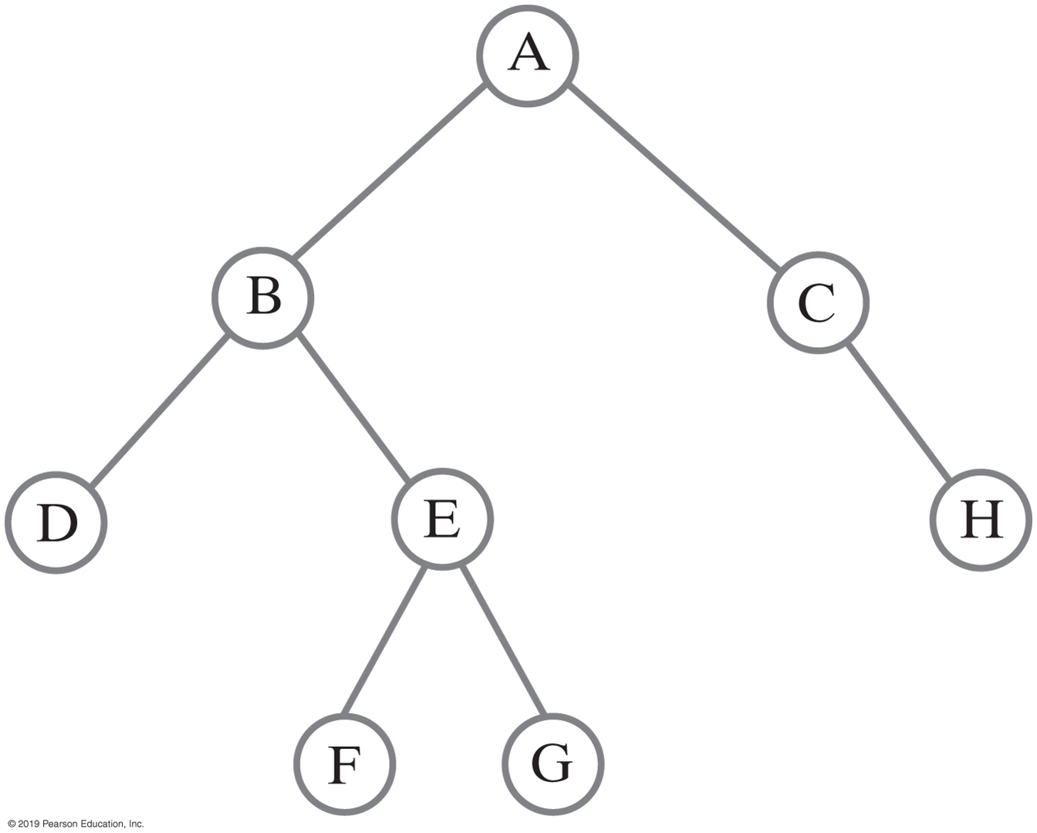
Building a Binary Tree
BinaryTreeInterface<String> dTree = new BinaryTree<>();
dTree.setTree("D", null, null);
BinaryTreeInterface<String> fTree = new BinaryTree<>();
fTree.setTree("F", null, null);
BinaryTreeInterface<String> gTree = new BinaryTree<>();
gTree.setTree("G", null, null);
BinaryTreeInterface<String> hTree = new BinaryTree<>();
hTree.setTree("H", null, null);
BinaryTreeInterface<String> emptyTree = new BinaryTree<>();
// Form larger subtrees
BinaryTreeInterface<String> eTree = new BinaryTree<>();
eTree.setTree("E", fTree, gTree); // Subtree rooted at E
BinaryTreeInterface<String> bTree = new BinaryTree<>();
bTree.setTree("B", dTree, eTree); // Subtree rooted at B
BinaryTreeInterface<String> cTree = new BinaryTree<>();
cTree.setTree("C", emptyTree, hTree); // Subtree rooted at C
BinaryTreeInterface<String> aTree = new BinaryTree<>();
aTree.setTree("A", bTree, cTree); // Desired tree rooted at A
FIGURE 24-14 A binary tree whose nodes contain one-letter strings
Java statements that build a tree

Slide 29
Building a Binary Tree
// Display root, height, number of nodes
System.out.println("Root of tree contains " + aTree.getRootData());
System.out.println("Height of tree is " + aTree.getHeight());
System.out.println("Tree has " + aTree.getNumberOfNodes() + " nodes");
// Display nodes in preorder
System.out.println("A preorder traversal visits nodes in this order:");
Iterator<String> preorder = aTree.getPreorderIterator();
while (preorder.hasNext())
System.out.print(preorder.next() + " ");
System.out.println();
FIGURE 24-14 A binary tree whose nodes contain one-letter strings
Java statements that build a tree and then display some of its characteristics:

Slide 30
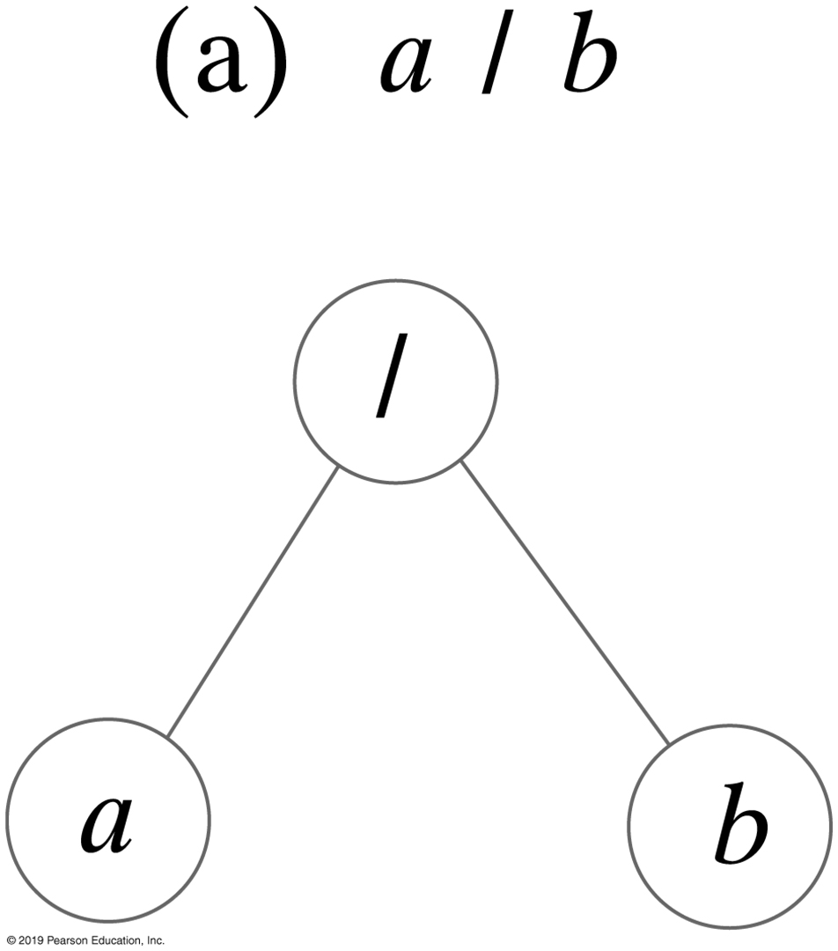
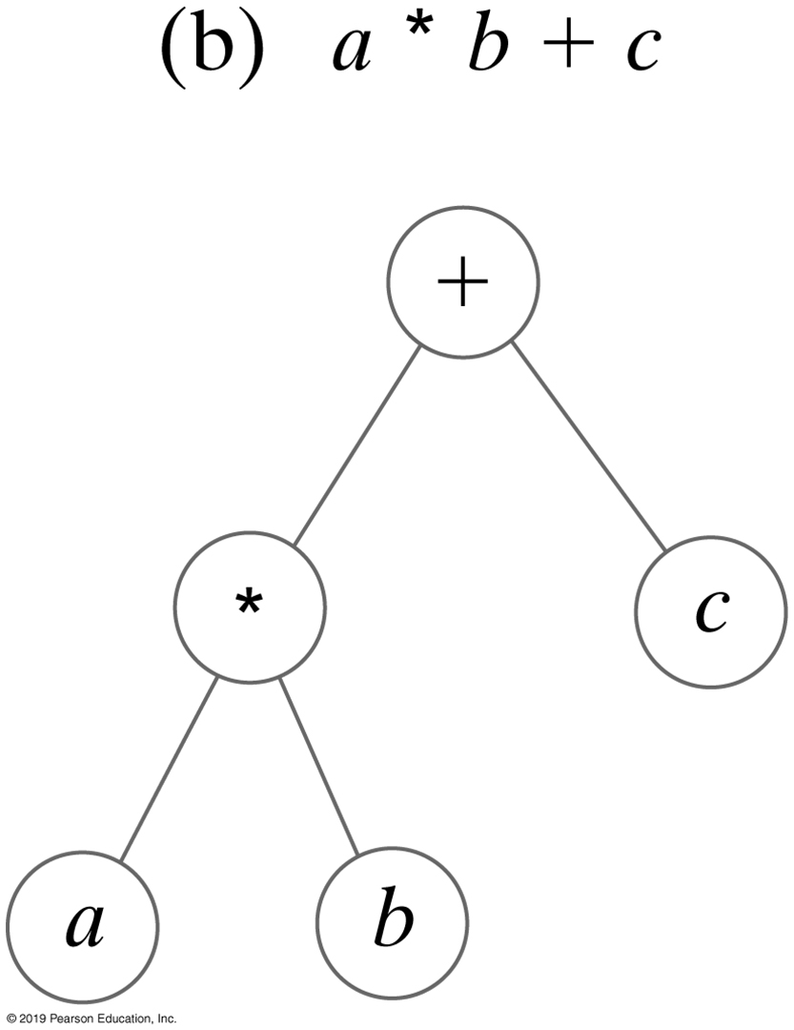
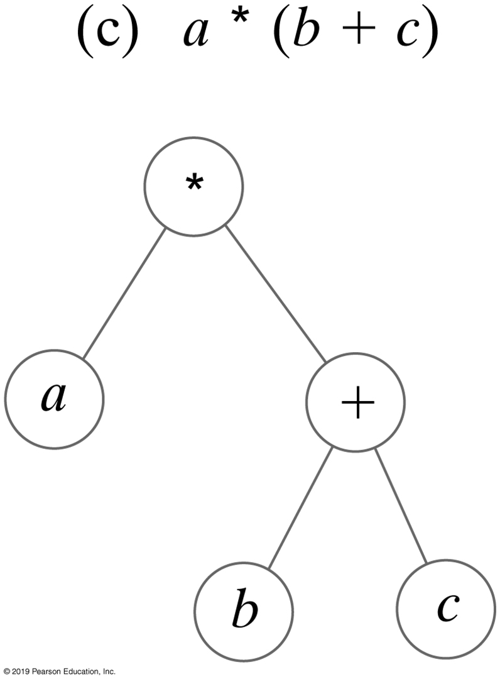
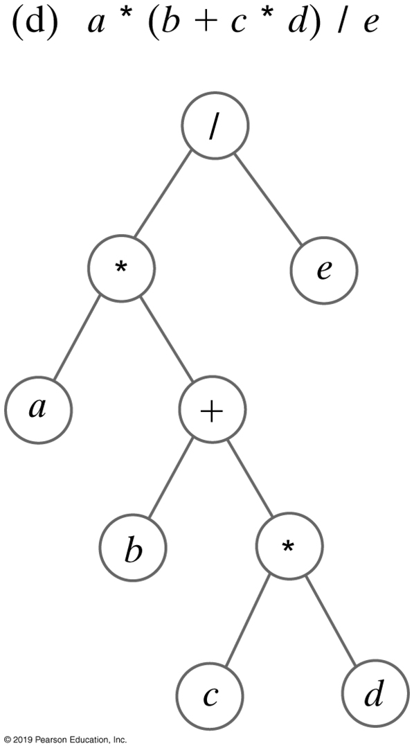
Expression Trees
FIGURE 24-15 Expression trees for four algebraic expressions

Slide 31
Expression Trees
Algorithm evaluate(expressionTree)
if (expressionTree is empty)
return 0
else
{
firstOperand = evaluate(left subtree of expressionTree)
secondOperand = evaluate(right subtree of expressionTree)
operator = the root of expressionTree
return the result of the operation operator and its operands firstOperand
and secondOperand
}
Algorithm for postorder traversal of an expression tree.

Slide 32
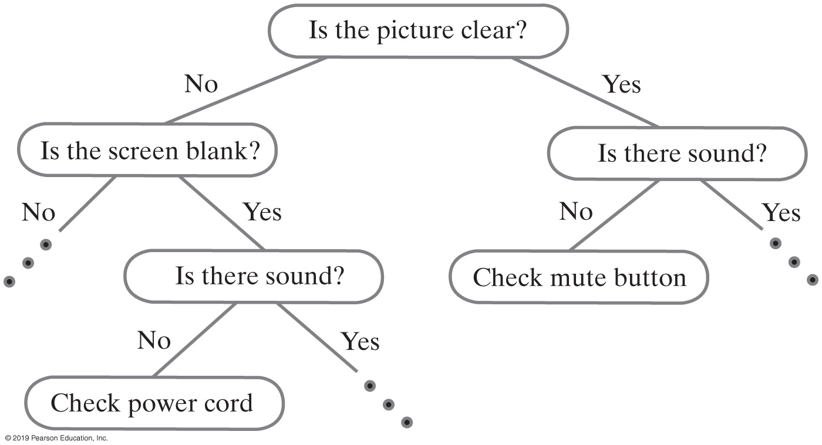
Expert System Using A Decision Tree
FIGURE 24-16 A portion of a binary decision tree

Slide 33
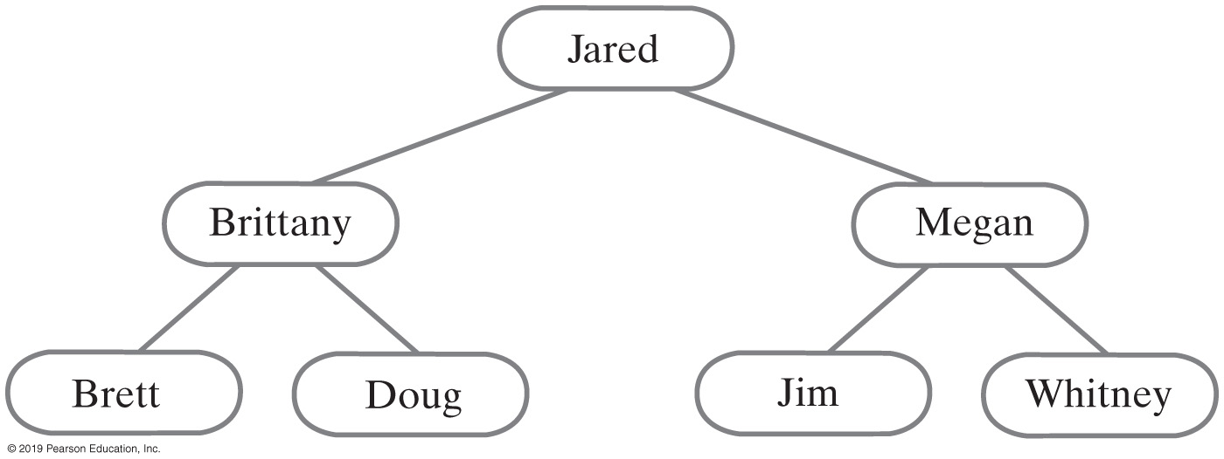
Binary Search Tree
For each node in a binary search tree
Node’s data is greater than all data in node’s left subtree
Node’s data is less than all data in node’s right subtree
Every node in a binary search tree is the root of a binary search tree
FIGURE 24-19 A binary search tree of names

Slide 34
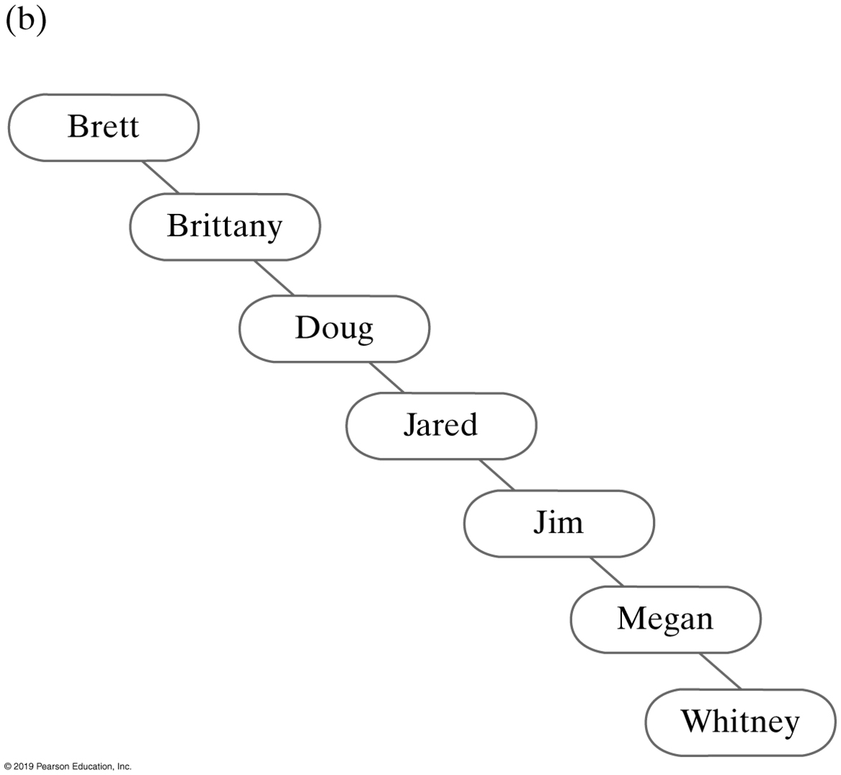
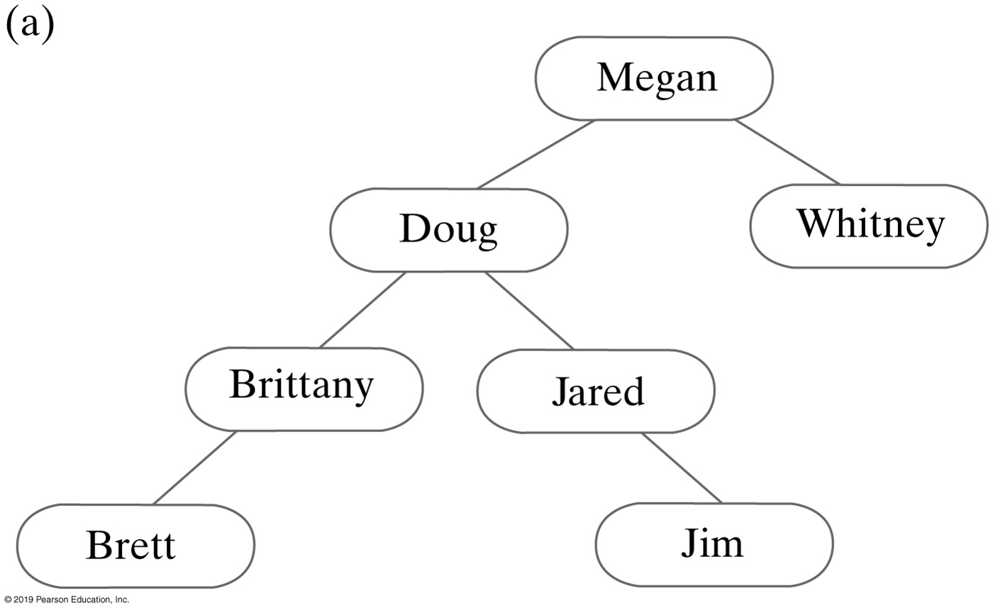
Binary Search Tree
FIGURE 24-20 Two binary search trees containing the same data as the tree in Figure 24-19

Slide 35
Binary Search Tree
Algorithm bstSearch(binarySearchTree, desiredObject)
// Searches a binary search tree for a given object.
// Returns true if the object is found.
if (binarySearchTree is empty)
return false
else if (desiredObject == object in the root of binarySearchTree)
return true
else if (desiredObject < object in the root of binarySearchTree)
return bstSearch(left subtree of binarySearchTree, desiredObject)
else
return bstSearch(right subtree of binarySearchTree, desiredObject)
Pseudocode for recursive search algorithm

Slide 36
Binary Search Tree
Efficiency of a search
Searching a binary search tree of height h is O(h)
To make searching a binary search tree efficient:
Tree must be as short as possible.

Slide 37
Heaps
Complete binary tree whose nodes contain Comparable objects and are organized as follows:
Each node contains an object no smaller/larger than objects in its descendants
Maxheap: object in node greater than or equal to its descendant objects
Minheap: object in node less than or equal to its descendant objects

Slide 38
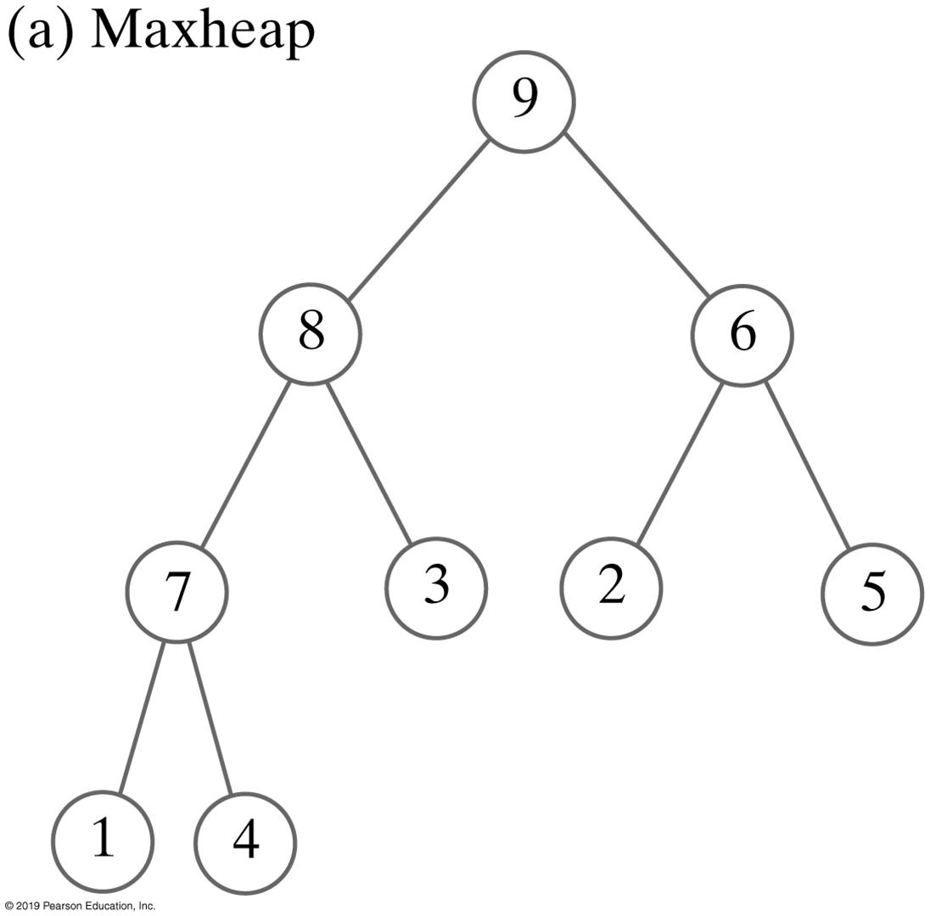

Heaps
FIGURE 24-21 Two heaps that contain the same values

Slide 39
Can a tree have more than one root?
Yes
No

Slide 40
If a tree has a root node, must that tree have leaves?
It might not have any leaves
It must have at least one leaf
It must have at least two leaves

Slide 41
In a tree with 10 nodes, how many of those nodes are children?
0
1
9
10
It can't be determined without more information

Slide 42
In a tree with 10 nodes, how many children does the root node have?
0
1
9
10
It can't be determined without more information

Slide 43
In a tree with 10 nodes, how many descendants does the root node have?
0
1
9
10
It can't be determined without more information

Slide 44
In a tree with 10 nodes, how many of those nodes are parents?
0
1
9
10
It can't be determined without more information

Slide 45
In a tree with 10 nodes, what is the largest possible height of the tree?
0
1
9
10
It can't be determined without more information

Slide 46
In a tree with 10 nodes, what is the smallest possible height of the tree?
0
1
2
5
It can't be determined without more information

Slide 47
Given two nodes, A and B, in a tree: how many paths will there be between A and B?
At least 1
At most 1
Exactly 1
None of the above

Slide 48
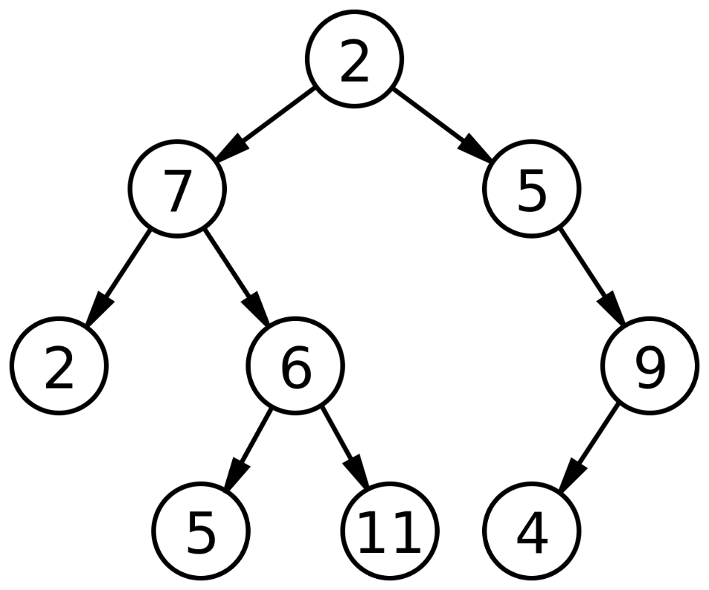
Consider the following tree:
What is the height?
What is the height of the left subtree?
How many leaves?

Slide 49
A binary tree has 30 nodes. What is its largest possible height?
14
15
29
30
None of these

Slide 50
A binary tree has 30 nodes. What is its smallest possible height?
3
4
5
6
None of these

Slide 51
What is the fewest number of nodes in a complete binary tree with height 6?
31
32
63
64
None of these

Slide 52
How many nodes are in a full binary tree with height 6?

Slide 53
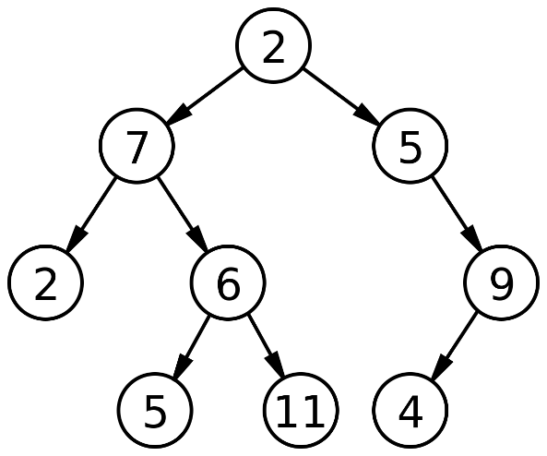
What happens if we call print(root)?
public void print(Node n) {
Node current = n;
while (current != null) {
System.out.print(n.data);
current = current.left;
}
}

Slide 54
I have a binary tree. The root's left subtree has 14 nodes. The root's right subtree has 10 nodes. How many nodes are in the tree?
10
14
24
25

Slide 55
I have a binary tree. The root's left subtree has a height of 7. The root's right subtree has a height of 10. What is the height of my binary tree?
7
8
10
11
17
18

Slide 56
End
Chapter 24

Slide 57
Data Structures and Abstractions with Java™
5th Edition
Chapter 25
Tree Implementations

Slide 58
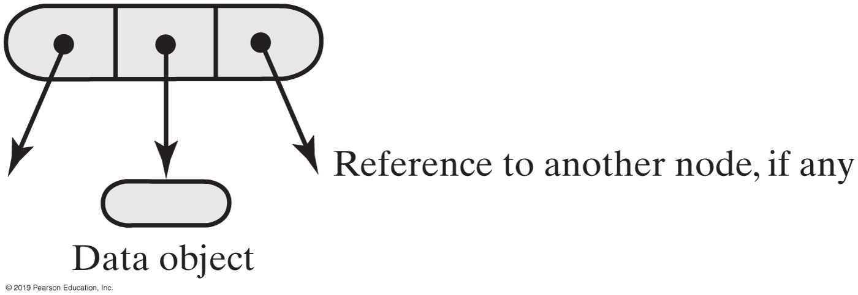
Nodes in a Binary Tree
FIGURE 25-1 A node in a binary tree

Slide 59
Creating a Basic Binary Tree (Part 1)
package TreePackage;
import java.util.Iterator;
import java.util.NoSuchElementException;
import StackAndQueuePackage.*; // Needed by tree iterators
/** A class that implements the ADT binary tree. */
public class BinaryTree<T> implements BinaryTreeInterface<T>
{
private BinaryNode<T> root;
public BinaryTree()
{
root = null;
} // end default constructor
public BinaryTree(T rootData)
{
root = new BinaryNode<>(rootData);
} // end constructor
public BinaryTree(T rootData, BinaryTree<T> leftTree, BinaryTree<T> rightTree)
{
initializeTree(rootData, leftTree, rightTree);
} // end constructor
LISTING 25-2 A first draft of the class BinaryTree

Slide 60
Creating a Basic Binary Tree (Part 2)
public void setTree(T rootData, BinaryTreeInterface<T> leftTree,
BinaryTreeInterface<T> rightTree)
{
initializeTree(rootData, (BinaryTree<T>)leftTree,
(BinaryTree<T>)rightTree);
} // end setTree
private void initializeTree(T rootData, BinaryTree<T> leftTree,
BinaryTree<T> rightTree)
{
// < FIRST DRAFT - See Segments 25.4 - 25.7 for improvements. >
root = new BinaryNode<T>(rootData);
if (leftTree != null)
root.setLeftChild(leftTree.root);
if (rightTree != null)
root.setRightChild(rightTree.root);
} // end initializeTree
/* Implementations of setRootData, getRootData, getHeight, getNumberOfNodes,
isEmpty, clear, and the methods specified in TreeIteratorInterface are here.
. . . */
} // end BinaryTree
LISTING 25-2 A first draft of the class BinaryTree

Slide 61
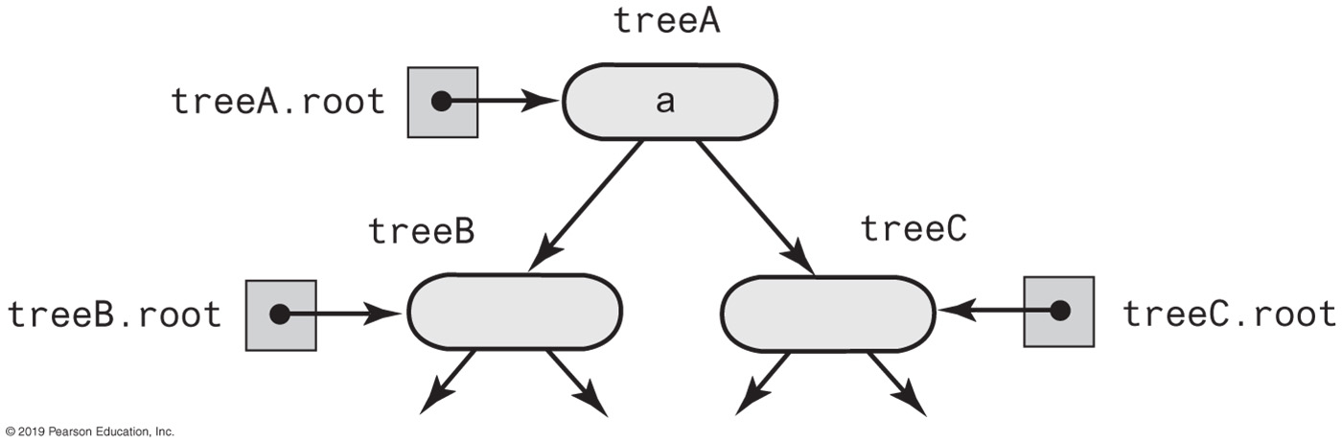
Creating a Binary Tree
treeA.setTree(a, treeB, treeC);
FIGURE 25-2 The binary tree treeA shares nodes with treeB and treeC

Slide 62
The Method copy
/** Copies the subtree rooted at this node. */
public BinaryNode<T> copy()
{
BinaryNode<T> newRoot = new BinaryNode<>(data);
if (leftChild != null)
newRoot.setLeftChild(leftChild.copy());
if (rightChild != null)
newRoot.setRightChild(rightChild.copy());
return newRoot;
} // end copy
Definition of the method copy in the class BinaryNode

Slide 63
The Method initializeTree
private void initializeTree(T rootData, BinaryTree<T> leftTree, BinaryTree<T> rightTree)
{
root = new BinaryNode<>(rootData);
if ((leftTree != null) && !leftTree.isEmpty())
root.setLeftChild(leftTree.root.copy());
if ((rightTree != null) && !rightTree.isEmpty())
root.setRightChild(rightTree.root.copy());
} // end initializeTree
Method initializeTree can invoke copy to copy the nodes from the two given subtrees

Slide 64
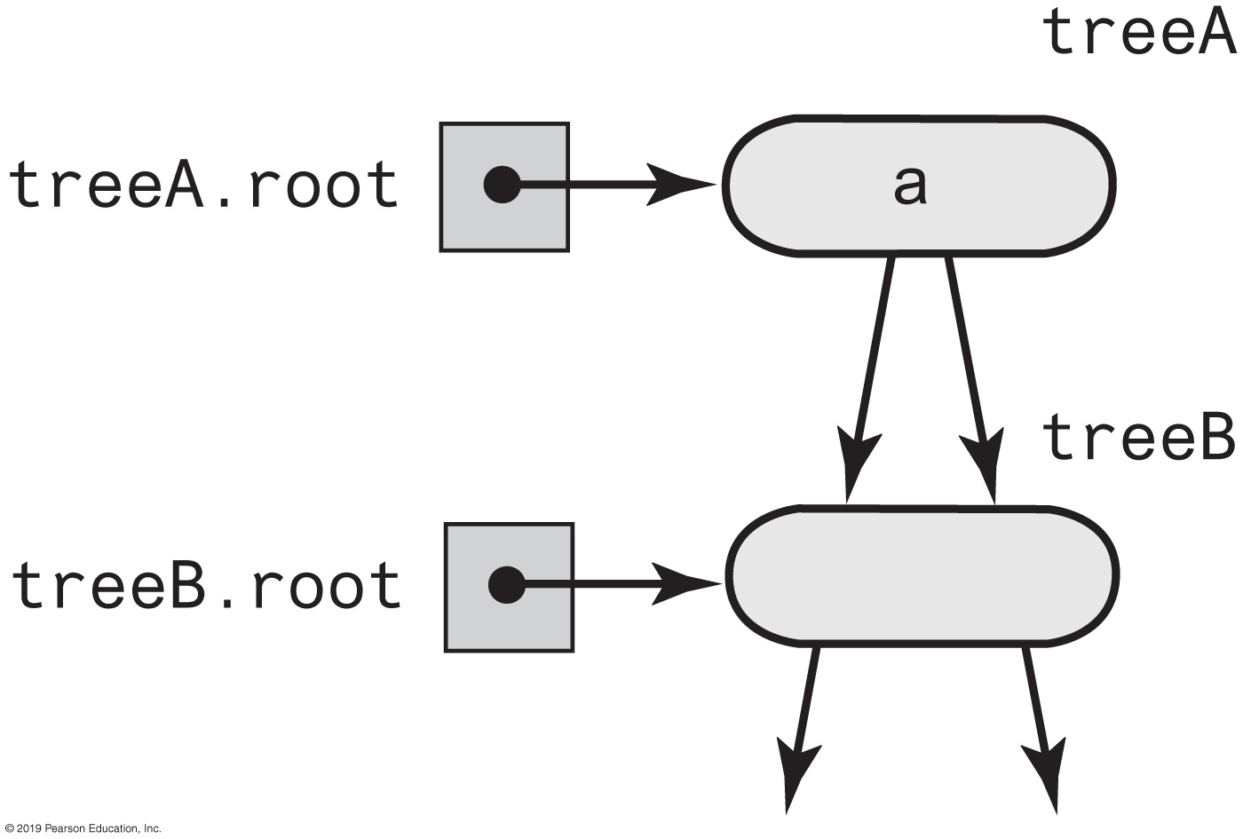
Additional Challenges
FIGURE 25-3 treeA has identical subtrees

Slide 65
Method initializeTree Solution
If left subtree exists and not empty,
attach root node to r as left child.
Create root node r containing given data.
If right subtree exists, not empty, and distinct from left subtree,
attach root node to r as a right child.
But if right and left subtrees are same,
attach copy of right subtree to r instead.
If the left subtree exists and differs from the tree object used to call initializeTree,
set the subtree’s data field root to null.
If right subtree exists and differs from the tree object used to call initializeTree,
set subtree’s data field root to null.

Slide 66
Method initializeTree Solution
private void initializeTree(T rootData, BinaryTree<T> leftTree,
BinaryTree<T> rightTree)
{
root = new BinaryNode<>(rootData);
if ((leftTree != null) && !leftTree.isEmpty())
root.setLeftChild(leftTree.root);
if ((rightTree != null) && !rightTree.isEmpty())
{
if (rightTree != leftTree)
root.setRightChild(rightTree.root);
else
root.setRightChild(rightTree.root.copy());
} // end if
if ((leftTree != null) && (leftTree != this))
leftTree.clear();
if ((rightTree != null) && (rightTree != this))
rightTree.clear();
} // end initializeTree
An implementation of initializeTree

Slide 67
BinaryTree Accessor and Mutator Methods
public void setRootData(T rootData)
{
root.setData(rootData);
} // end setRootData
public T getRootData()
{
if (isEmpty())
throw new EmptyTreeException();
else
return root.getData();
} // end getRootData
protected void setRootNode(BinaryNode<T> rootNode)
{
root = rootNode;
} // end setRootNode
protected BinaryNode<T> getRootNode()
{
return root;
} // end getRootNode

Slide 68
More BinaryTree Methods
public int getHeight()
{
int height = 0;
if (root != null)
height = root.getHeight();
return height;
} // end getHeight
public int getNumberOfNodes()
{
int numberOfNodes = 0;
if (root != null)
numberOfNodes = root.getNumberOfNodes();
return numberOfNodes;
} // end getNumberOfNodes
Computing the Height and Counting Nodes

Slide 69
Methods within BinaryNode.
public int getHeight()
{
return getHeight(this); // Call private getHeight
} // end getHeight
private int getHeight(BinaryNode<T> node)
{
int height = 0;
if (node != null)
height = 1 + Math.max(getHeight(node.getLeftChild()),
getHeight(node.getRightChild()));
return height;
}

Slide 70
Methods within BinaryNode
public int getNumberOfNodes()
{
int leftNumber = 0;
int rightNumber = 0;
if (left != null)
leftNumber = left.getNumberOfNodes();
if (right != null)
rightNumber = right.getNumberOfNodes();
return 1 + leftNumber + rightNumber;
} // end getNumberOfNodes

Slide 71
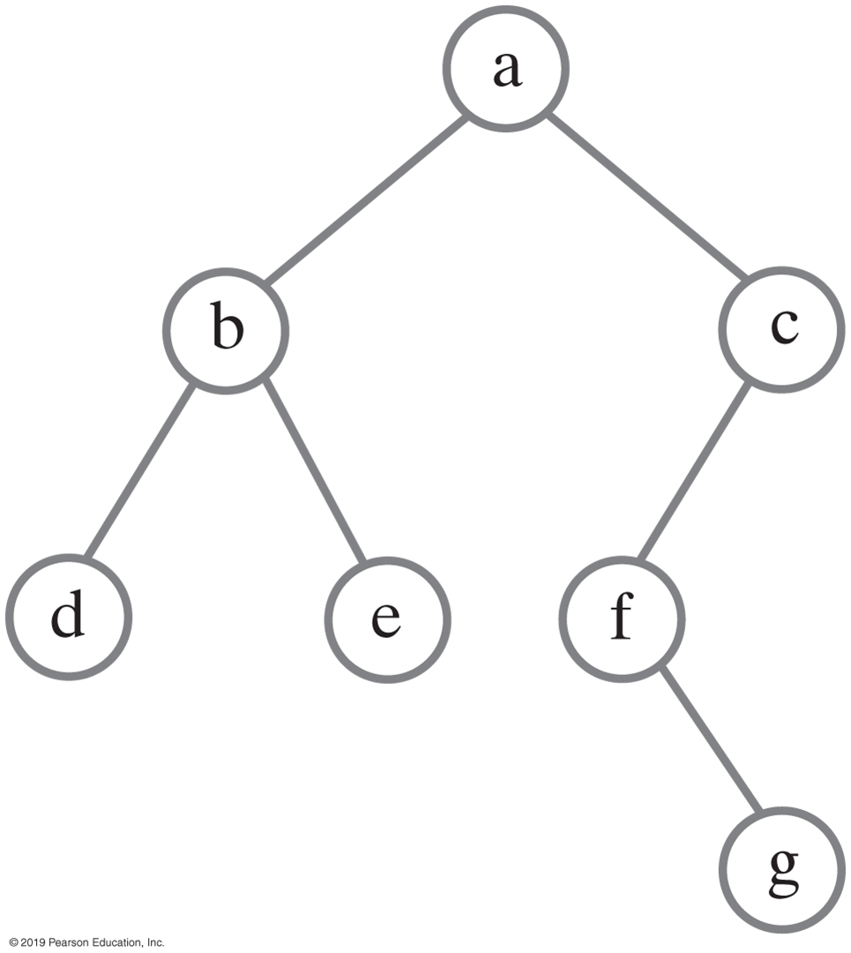
Traversing a binary tree recursively
public void inorderTraverse()
{
inorderTraverse(root);
} // end inorderTraverse
private void inorderTraverse(BinaryNode<T> node)
{
if (node != null)
{
inorderTraverse(node.getLeftChild());
System.out.println(node.getData());
inorderTraverse(node.getRightChild());
} // end if
} // end inorderTraverse
FIGURE 25-4 A binary tree

Slide 72
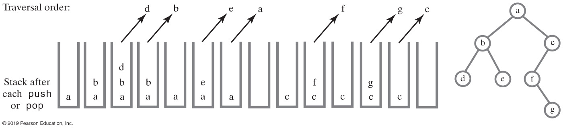
Non-recursive Traversal
FIGURE 25-5 Using a stack to perform an in-order traversal of a binary tree

Slide 73
Non-recursive Traversal
public void iterativeInorderTraverse()
{
StackInterface<BinaryNode<T>> nodeStack = new LinkedStack<>();
BinaryNode<T> currentNode = root;
while (!nodeStack.isEmpty() || (currentNode != null))
{
// Find leftmost node with no left child
while (currentNode != null)
{
nodeStack.push(currentNode);
currentNode = currentNode.getLeftChild();
} // end while
// Visit leftmost node, then traverse its right subtree
if (!nodeStack.isEmpty())
{
BinaryNode<T> nextNode = nodeStack.pop();
// Assertion: nextNode != null, since nodeStack was not empty
// before the pop
System.out.println(nextNode.getData());
currentNode = nextNode.getRightChild();
} // end if
} // end while
} // end iterativeInorderTraverse
Iterative version …

Slide 74
Traversals That Use An Iterator (Part 1)
private class InorderIterator implements Iterator<T>
{
private StackInterface<BinaryNode<T>> nodeStack;
private BinaryNode<T> currentNode;
public InorderIterator()
{
nodeStack = new LinkedStack<>();
currentNode = root;
} // end default constructor
public void remove()
{
throw new UnsupportedOperationException();
} // end remove
public boolean hasNext()
{
return !nodeStack.isEmpty() || (currentNode != null);
} // end hasNext
LISTING 25-3 The private inner class InorderIterator

Slide 75
Traversals That Use An Iterator (Part 2)
public T next()
{
BinaryNode<T> nextNode = null;
// Find leftmost node with no left child
while (currentNode != null)
{
nodeStack.push(currentNode);
currentNode = currentNode.getLeftChild();
} // end while
// Get leftmost node, then move to its right subtree
if (!nodeStack.isEmpty())
{
nextNode = nodeStack.pop();
// Assertion: nextNode != null, since nodeStack was not empty
// before the pop
currentNode = nextNode.getRightChild();
}
else
throw new NoSuchElementException();
return nextNode.getData();
} // end next
} // end InorderIterator
LISTING 25-3 The private inner class InorderIterator

Slide 76
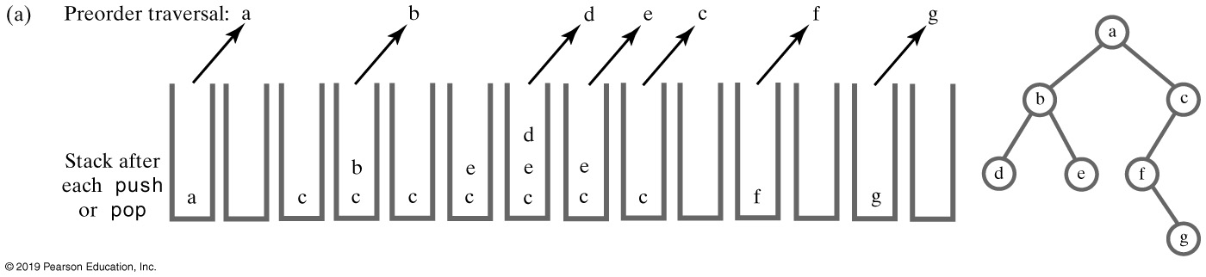
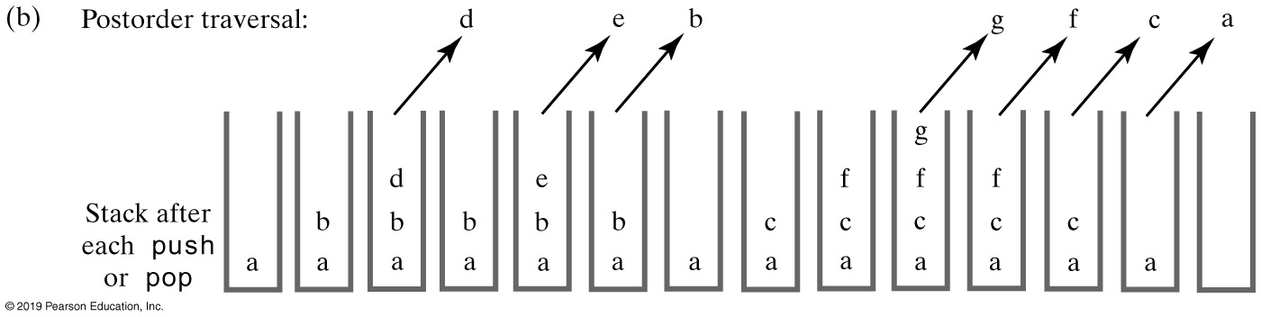
Using a Stack to Traverse a Binary Tree
FIGURE 25-6 Using a stack to traverse a binary tree in preorder and postorder

Slide 77
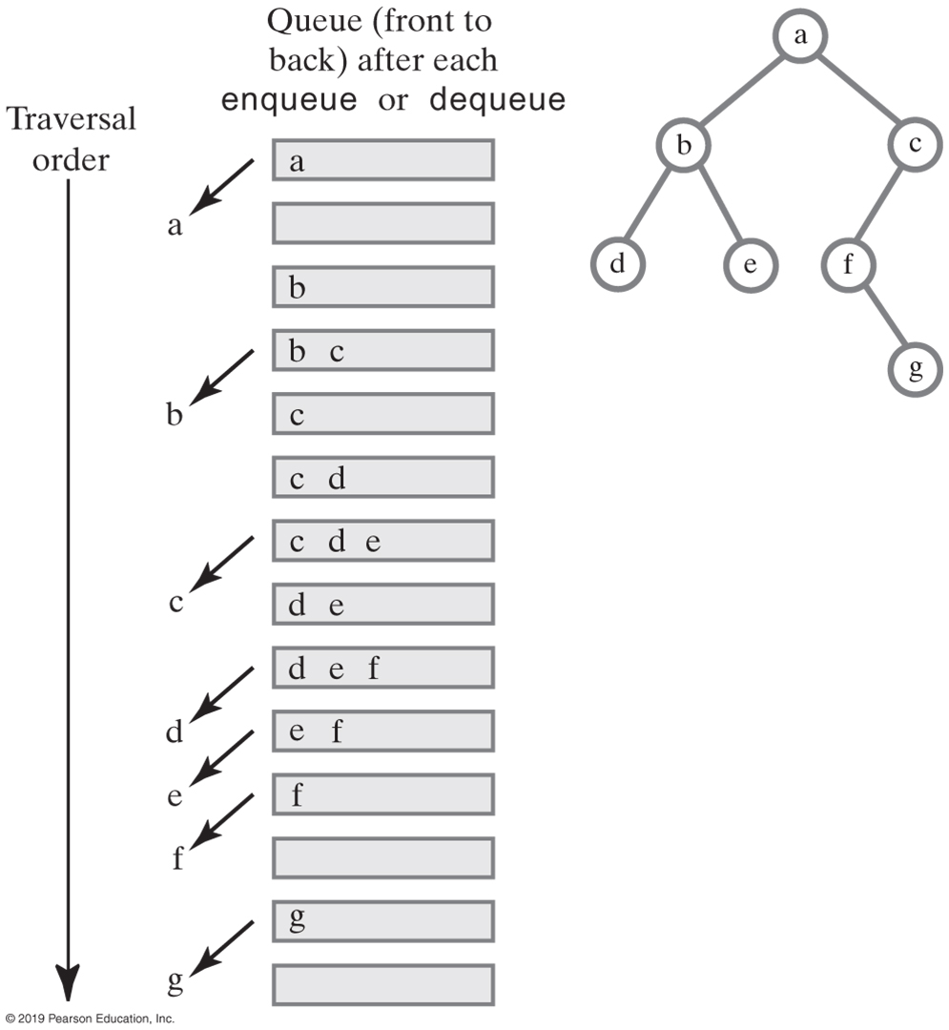
Using a Queue for Level-Order Traversal
FIGURE 25-7 Using a queue to traverse a binary tree in level order

Slide 78
Implementation of an Expression Tree
package TreePackage;
/** An interface for an expression tree. */
public interface ExpressionTreeInterface
extends BinaryTreeInterface<String>
{
/** Computes the value of the expression in this tree.
@return The value of the expression. */
public double evaluate();
} // end ExpressionTreeInterface
LISTING 25-4 An interface for an expression tree

Slide 79
Implementation of an Expression Tree (Part 1)
package TreePackage;
/** A class that implements an expression tree by extending BinaryTree. */
public class ExpressionTree extends BinaryTree<String>
implements ExpressionTreeInterface
{
public ExpressionTree()
{
} // end default constructor
public double evaluate()
{
return evaluate(getRootNode());
} // end evaluate
private double getValueOf(String variable)
{ // Strings allow multicharacter variables
double result = 0;
// To be defined.
return result;
} // end getValueOf
LISTING 25-5 The class ExpressionTree

Slide 80
Implementation of an Expression Tree (Part 1)
private double compute(String operator, double firstOperand, double secondOperand)
{
double result = 0;
// To be defined.
return result;
} // end compute
private double evaluate(BinaryNode<String> rootNode) {
double result;
if (rootNode == null)
result = 0;
else if (rootNode.isLeaf()) {
String variable = rootNode.getData();
result = getValueOf(variable);
}
else
{
double firstOperand = evaluate(rootNode.getLeftChild());
double secondOperand = evaluate(rootNode.getRightChild());
String operator = rootNode.getData();
result = compute(operator, firstOperand, secondOperand);
} // end if
return result;
} // end evaluate
} // end ExpressionTree
LISTING 25-5 The class ExpressionTree

Slide 81
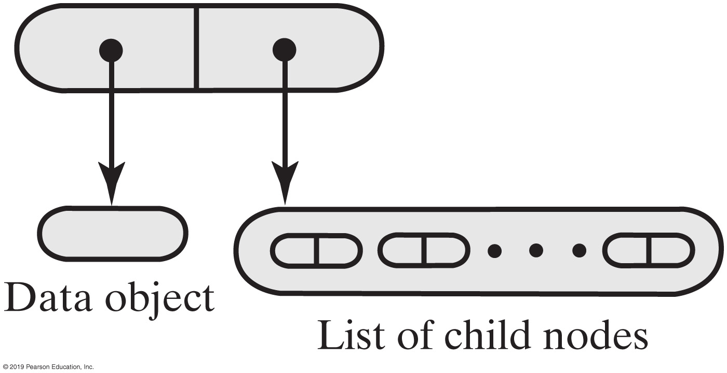
Representing General Trees
FIGURE 25-8 A node for a general tree

Slide 82
Representing General Trees
package TreePackage;
import java.util.Iterator;
/** An interface for a node in a general tree.*/
interface GeneralNodeInterface<T>
{
public T getData();
public void setData(T newData);
public boolean isLeaf();
public Iterator<GeneralNodeInterface<T>> getChildrenIterator();
public void addChild(GeneralNodeInterface<T> newChild);
} // end GeneralNodeInterface
LISTING 25-6 An interface for a node in a general tree

Slide 83
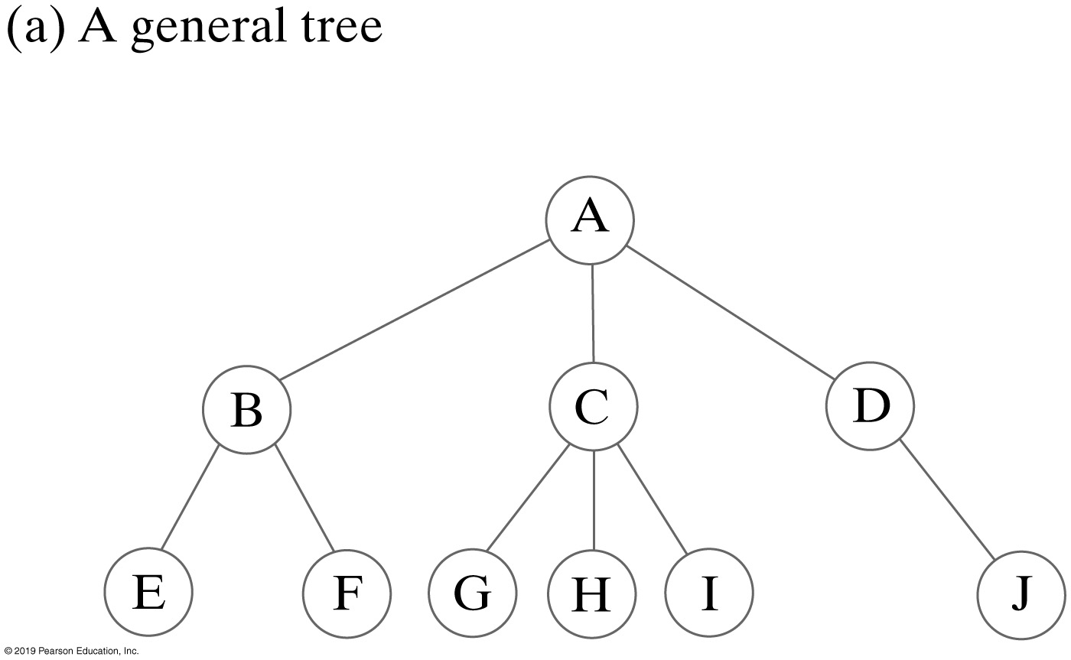
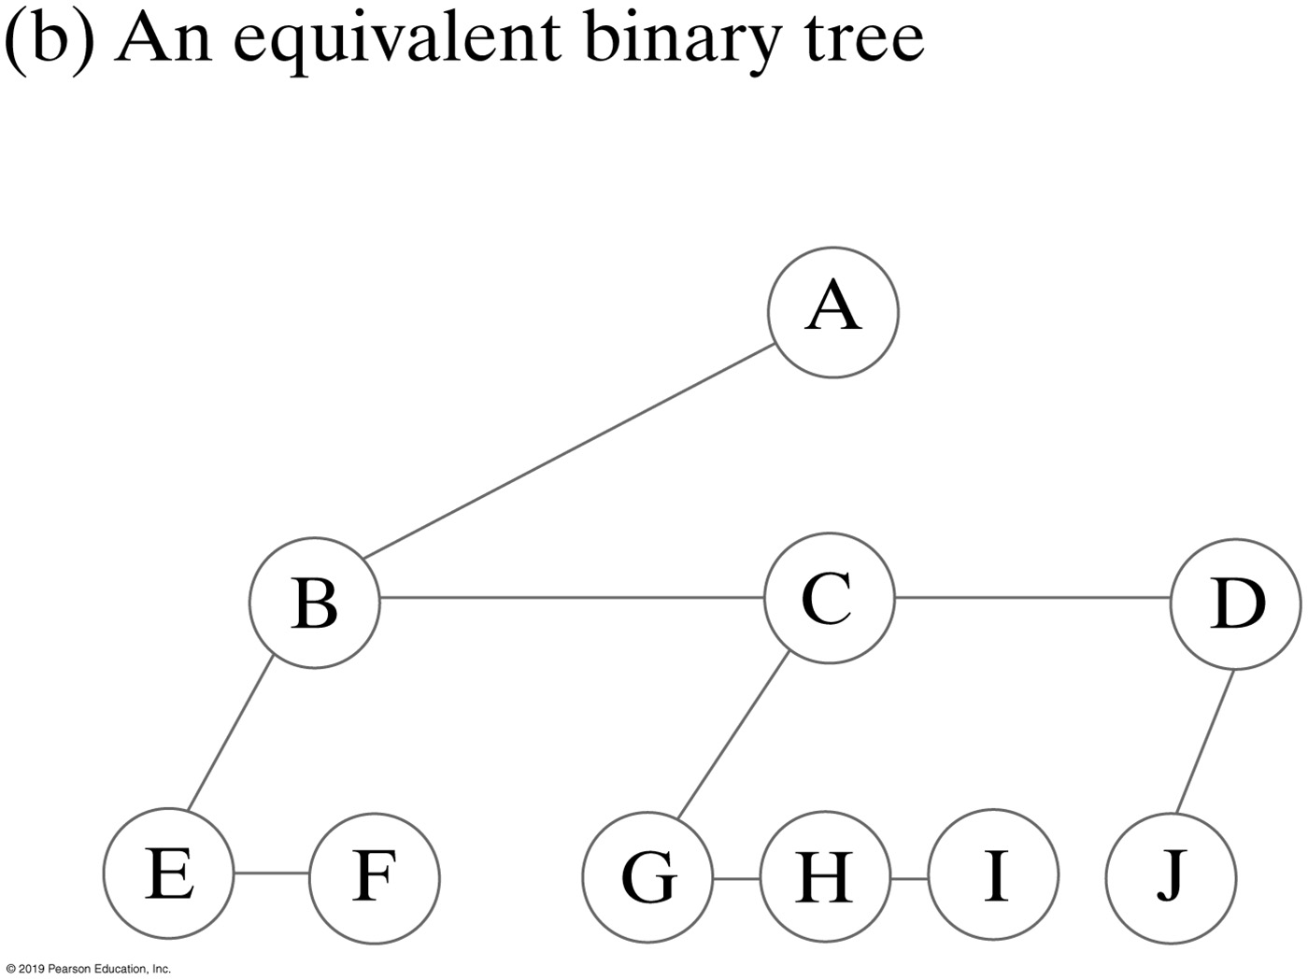
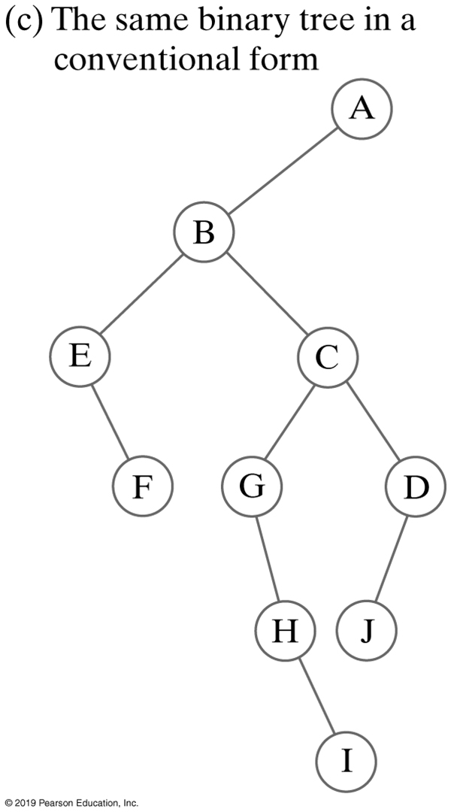
Representing General Trees
FIGURE 25-9 A general tree and two views of an equivalent binary tree

Slide 84
End
Chapter 25

